Slide 1
Data Visualization

Slide 2
Agenda:
1 | Introduction to Matplotlib
2 | Introduction to Seaborn
3 | Practical Visualization Examples

Slide 3


Understanding Data Visualization
What is Data Visualization?
Graphical representation of data and information.
Importance of Data Visualization
Helps understand complex datasets easily.
Highlights patterns, trends, and relationships.
Uses for Data Visualization
Communicates insights to stakeholders effectively.
Identifies trends and data patterns.
9/4/2024
6

Slide 4

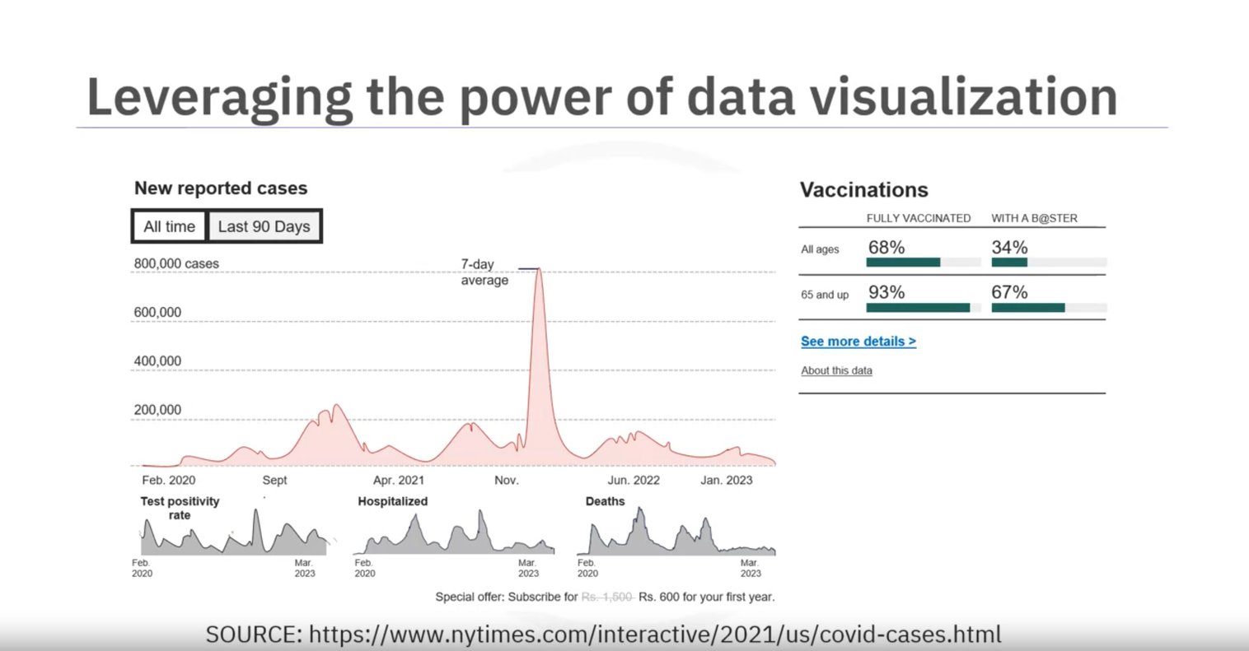
9/4/2024
7

Slide 5
Best Practices in Data Visualization
Choosing the Right Visualization
Different types for different data types.
Keeping Visualizations Simple
Clear labels, titles, and legends.
Audience Consideration
Tailoring visualizations to audience needs.
Examples of Effective and Ineffective Visualizations
Example of bad data visualization with clutter.
9/4/2024
8

Slide 6

Darkhorse Analytics' effective approach
When creating a visual, always remember:
Less is more effective
Less is more attractive
Less is more impactful
Cause & Effect, but Hidden
Data Over Opinions
Know the System Before You Move
9/4/2024
11

Slide 7
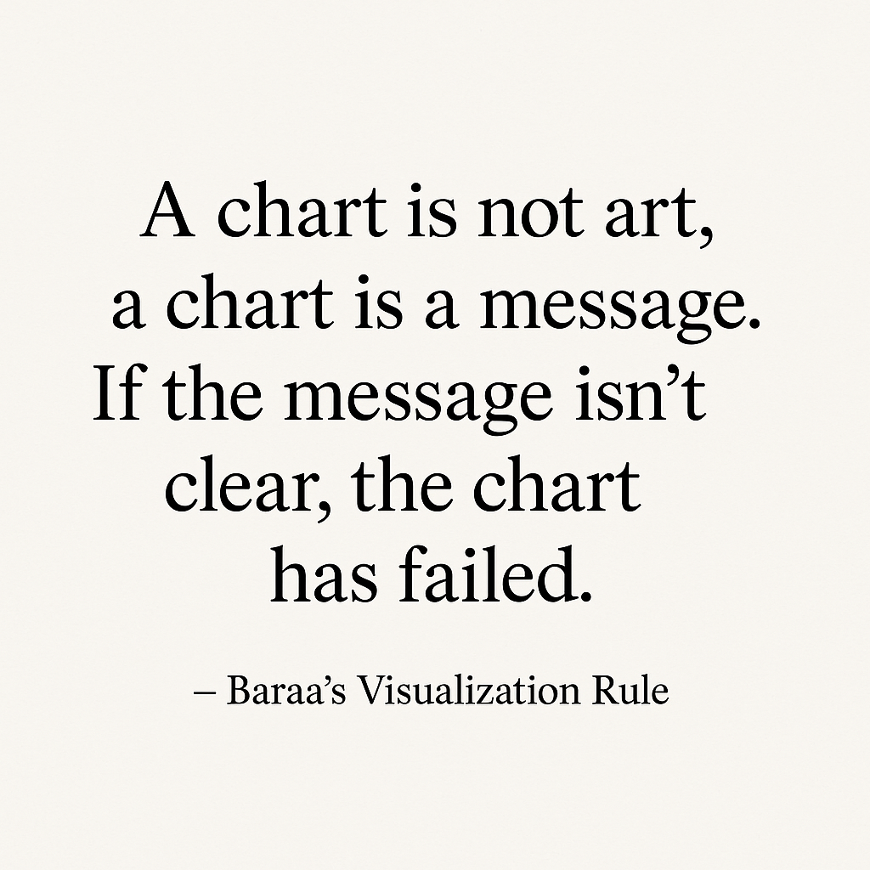

Slide 8
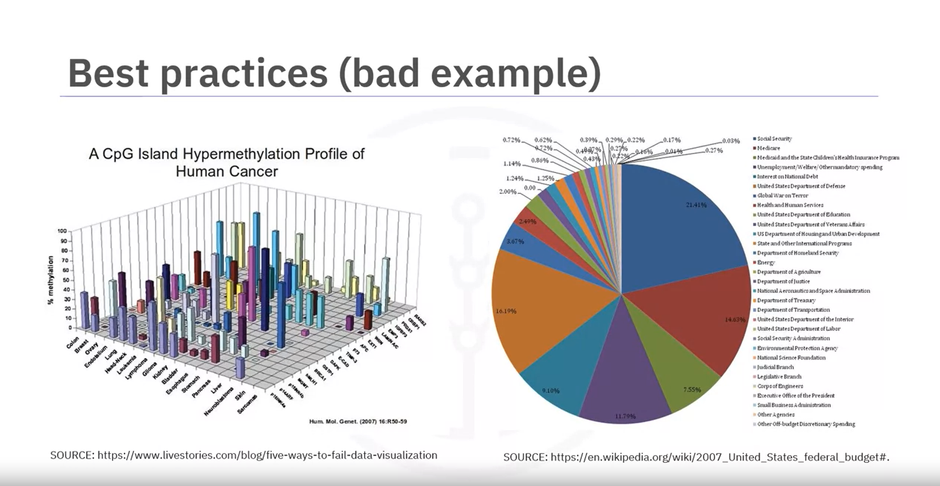
9/4/2024
9

Slide 9
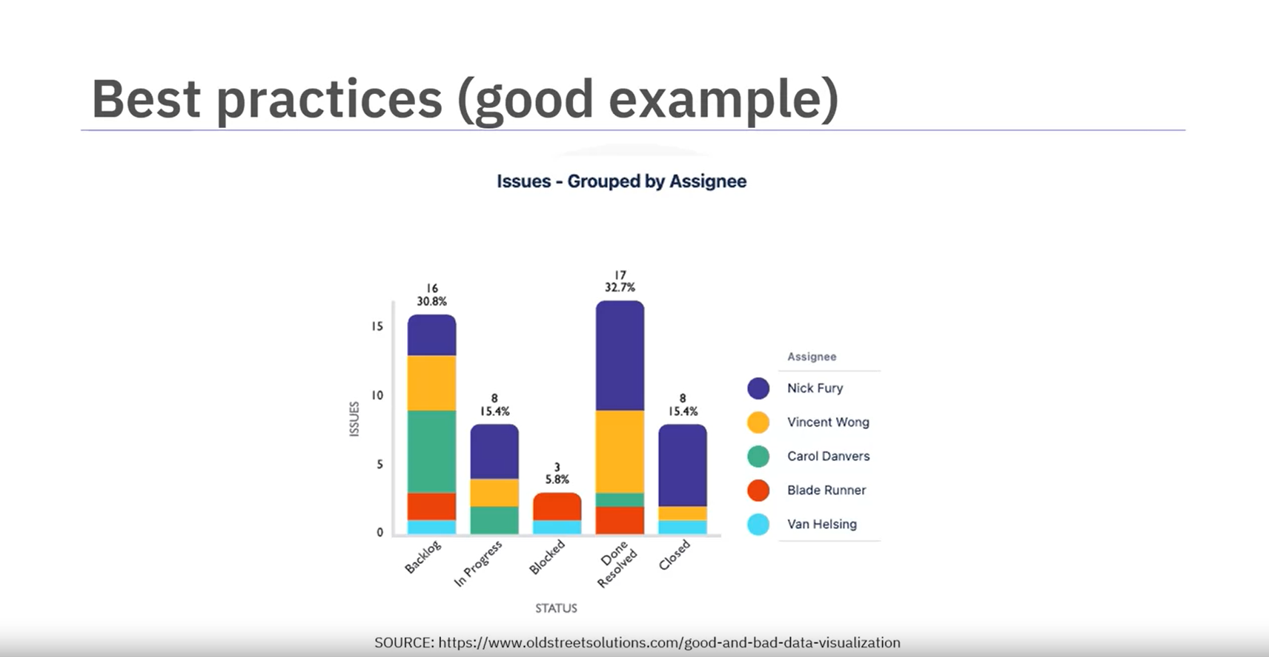
9/4/2024
10

Slide 10
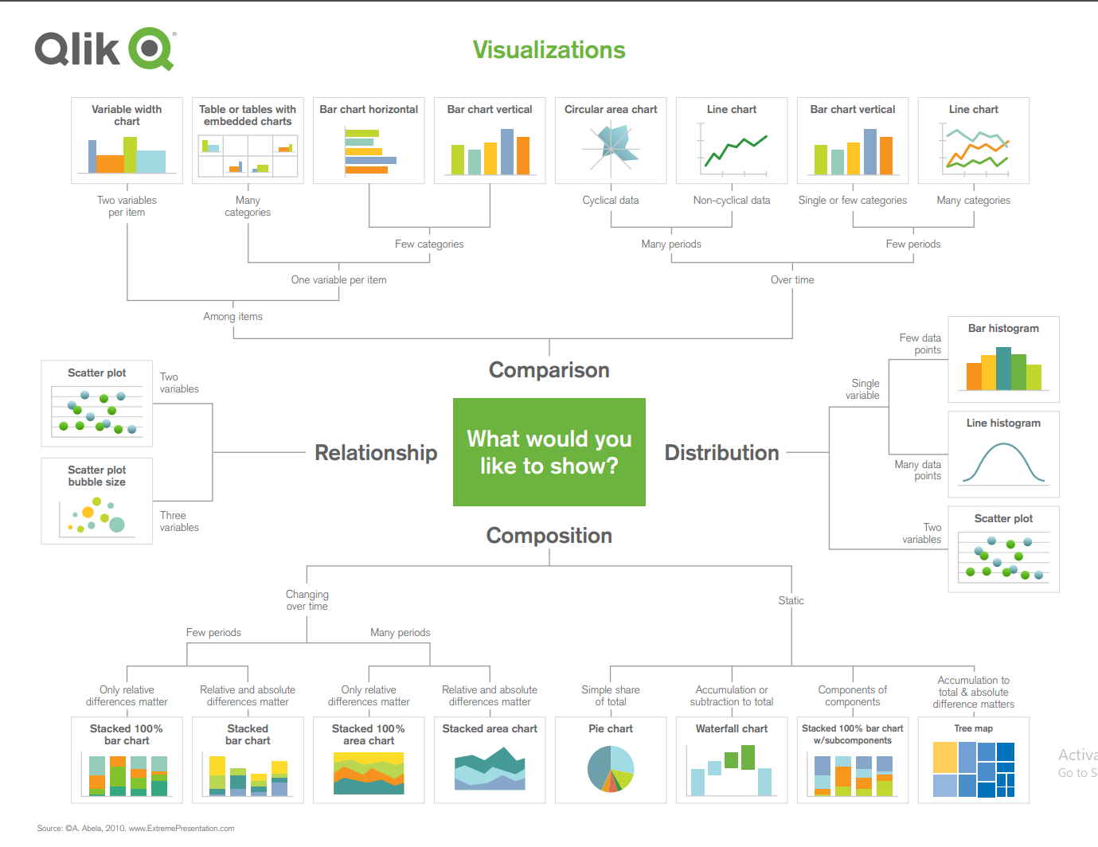
Added
By Eng. Baraa

Slide 11
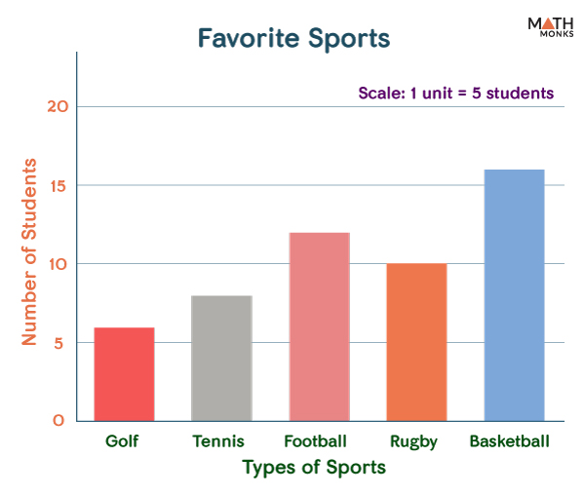
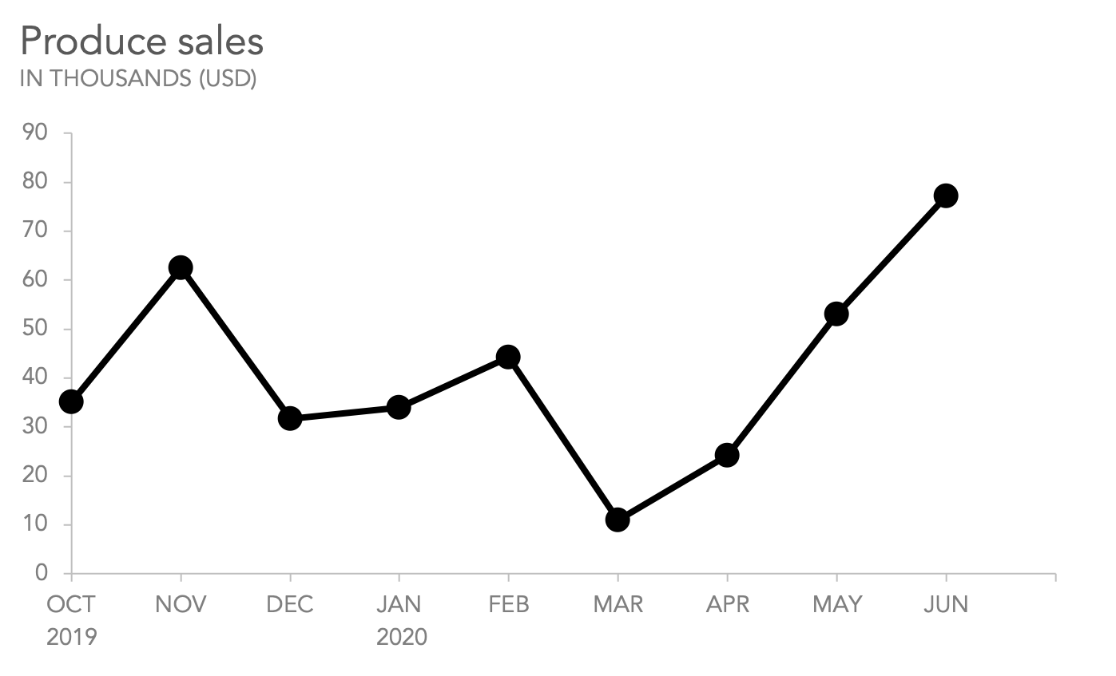
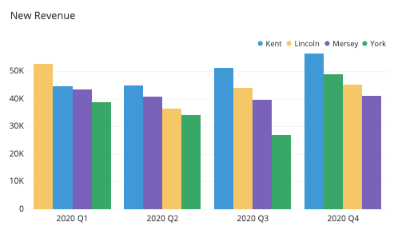
Data Visualization Cheat Sheet What do you want to show?
Comparison
👉 When you want to show differences between values or categories.
✅ Best Visuals:
📊 Bar Chart → Compare branches
📈 Line Chart → Trends over time
🟦 Grouped Bar → Two groups in categories

Slide 12
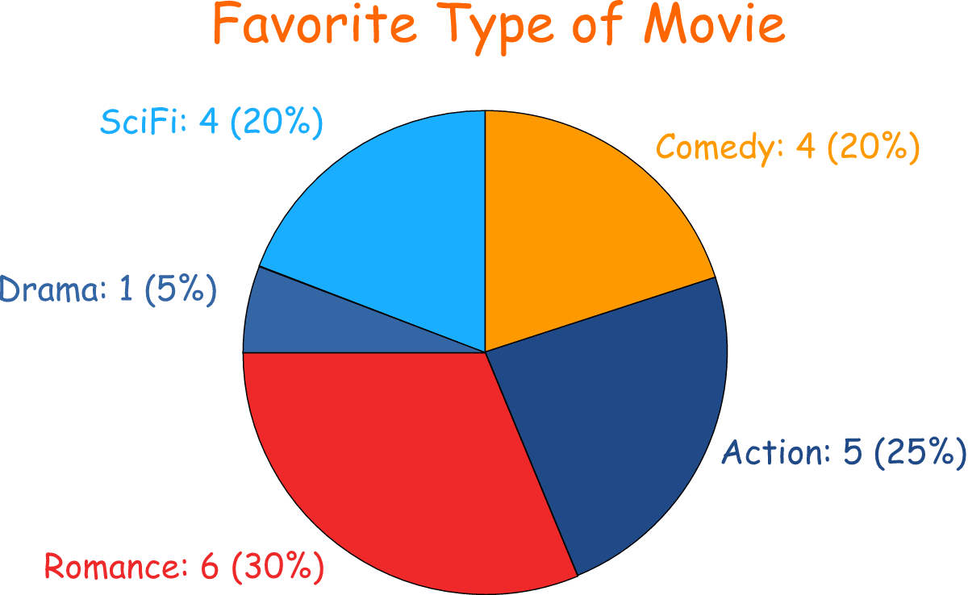
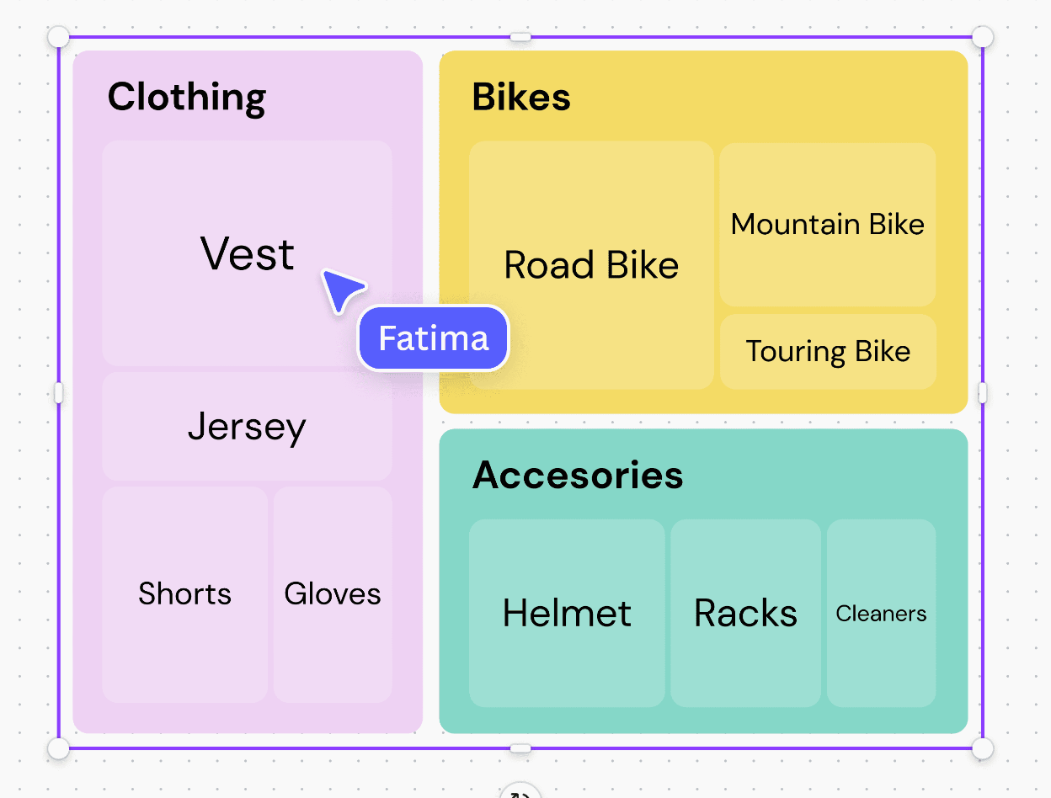
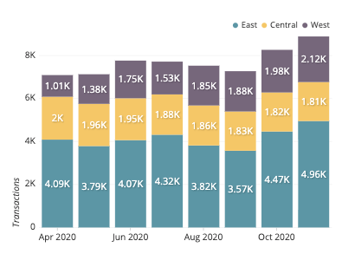
Tree Map
Data Visualization Cheat Sheet What do you want to show?
Composition
👉 When you want to show how the whole is divided into parts.
✅ Best Visuals:
🥧 Pie Chart → Percentages
📊 Stacked Bar → Parts of a bar
🟩 Tree Map → Area for each part
📈 Stacked Area → Parts changing over time
Stacked Bar

Slide 13
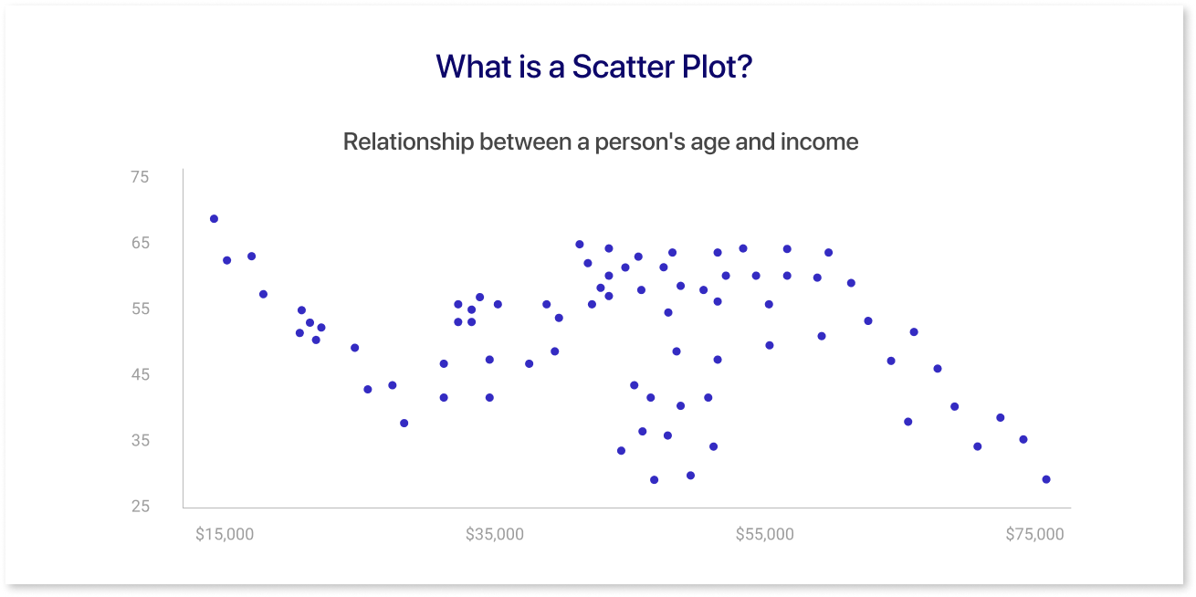
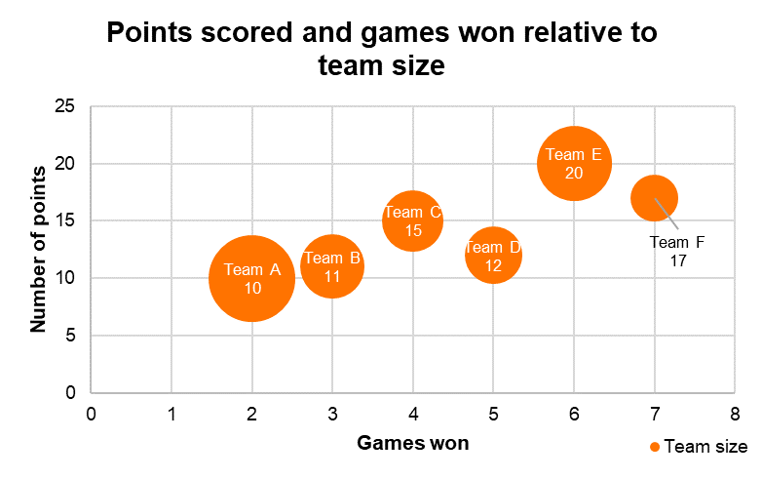
Data Visualization Cheat Sheet What do you want to show?
Relationship
👉 When you want to show connections or correlations between variables.
✅ Best Visuals:
🔵 Scatter Plot → Variable × Variable
🔵⚪ Bubble Chart → Add a third variable (size)
🌡 Heatmap → Correlation strength
📉 Trend Line → Direction of relationship

Slide 14
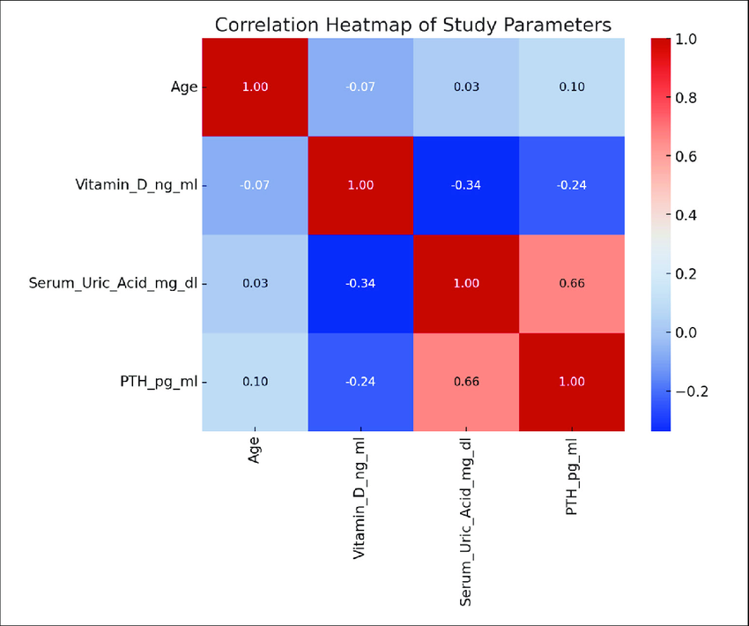

Slide 15
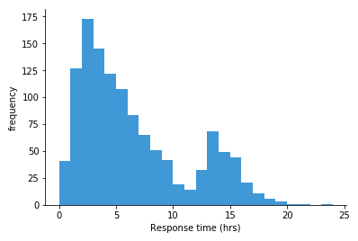
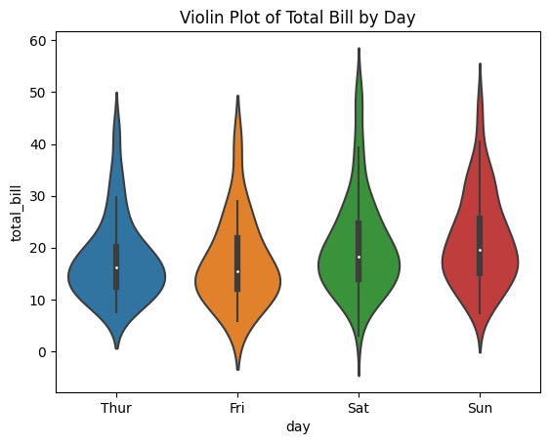
Data Visualization Cheat Sheet What do you want to show?
Distribution
👉 When you want to show the shape of data and outliers.
✅ Best Visuals:
Bar Chart → used for discrete data (Branchs: Gaza, Egypt , Dubai)
Histogram → used for continuous data ( Age, Salary , Grades )
📦 Boxplot → Median + Outliers
🌊 Density Plot (KDE) → Smooth curve
🎻 Violin Plot → Box + Density combined

Slide 16
Quick Rules
Few categories? → Bar / Pie
Over time? → Line / Area
Relationship? → Scatter / Heatmap
Distribution? → Histogram / Boxplot
📌 Rule: Always ask: What do I want to show?

Slide 17
💡 Hints 💡
🟦 Comparison
If you want to focus on fine differences between categories → Bar Chart.
If you want to track changes over time → Line Chart.
🟩 Composition
If you want clear and simple percentages → Pie Chart.
If you have time series data and want to see how the whole and its parts change over time → Stacked Area Chart.
If you want to compare categories across multiple groups without a time dimension → Stacked Bar Chart.
🟧 Distribution
If your goal is to see the overall data pattern → Histogram.
If your goal is to detect outliers (unusual values) → Box Plot.
🟥 Relationship
If you have two variables only → Scatter Plot.
If you have three variables → Bubble Chart.
If you want to see clusters in the data → Scatter Clusters.

Slide 18
Choose the Right Chart – Real-World Scenarios

Slide 19
Module I
Introduction Data visualization tools
Plot Libraries
9/4/2024
25

Slide 20
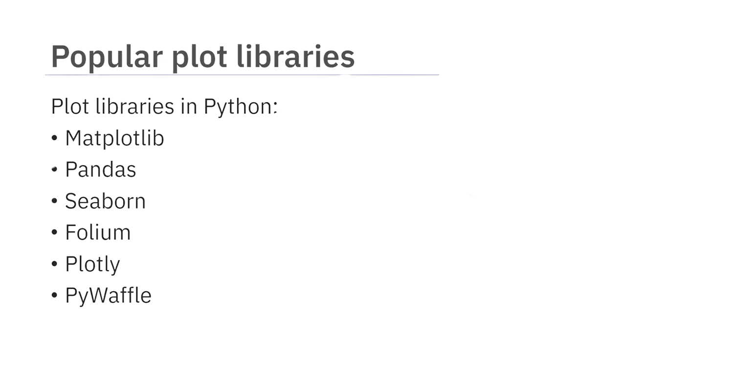
Popular plot libraries:
9/4/2024
26

Slide 21
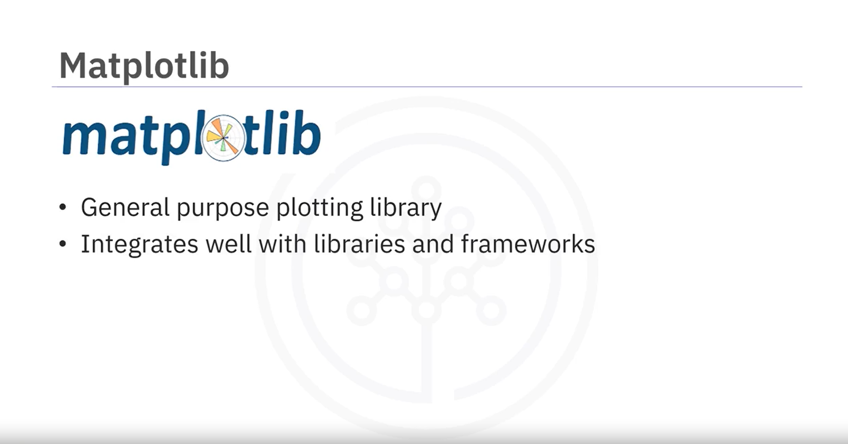
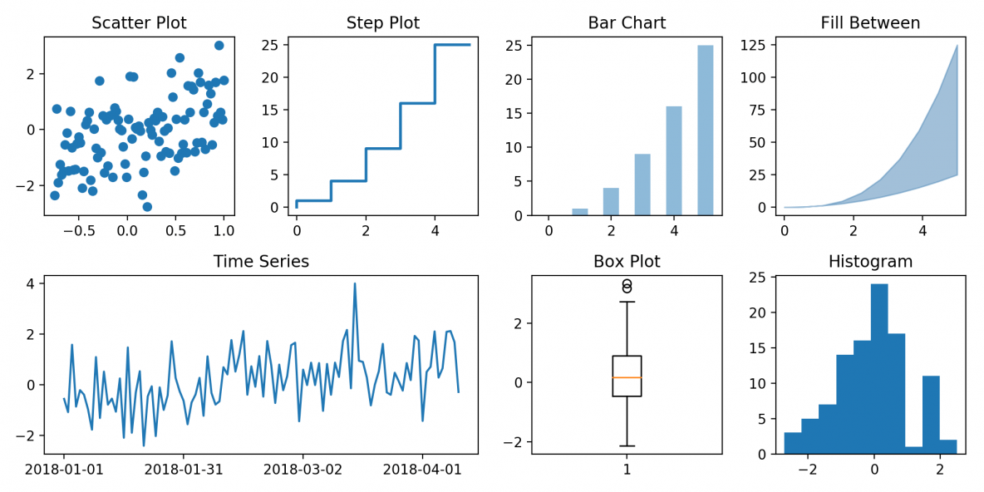
Matplotlib:
9/4/2024
27

Slide 22
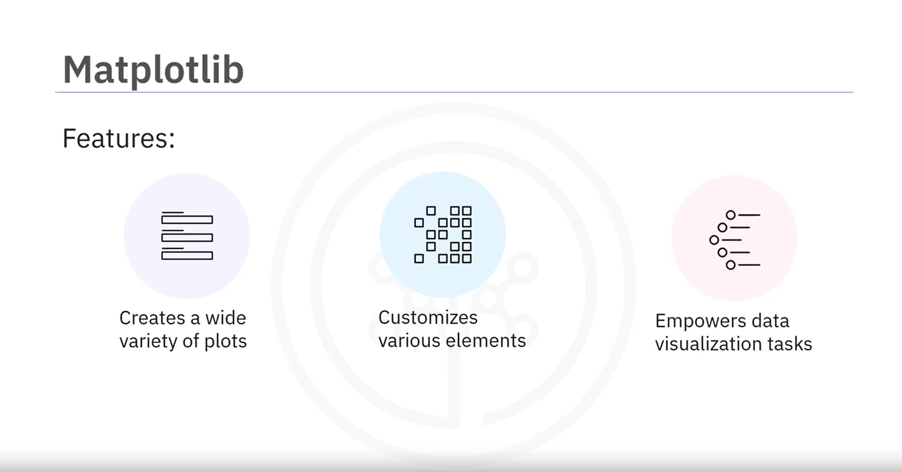
Matplotlib:
9/4/2024
28

Slide 23
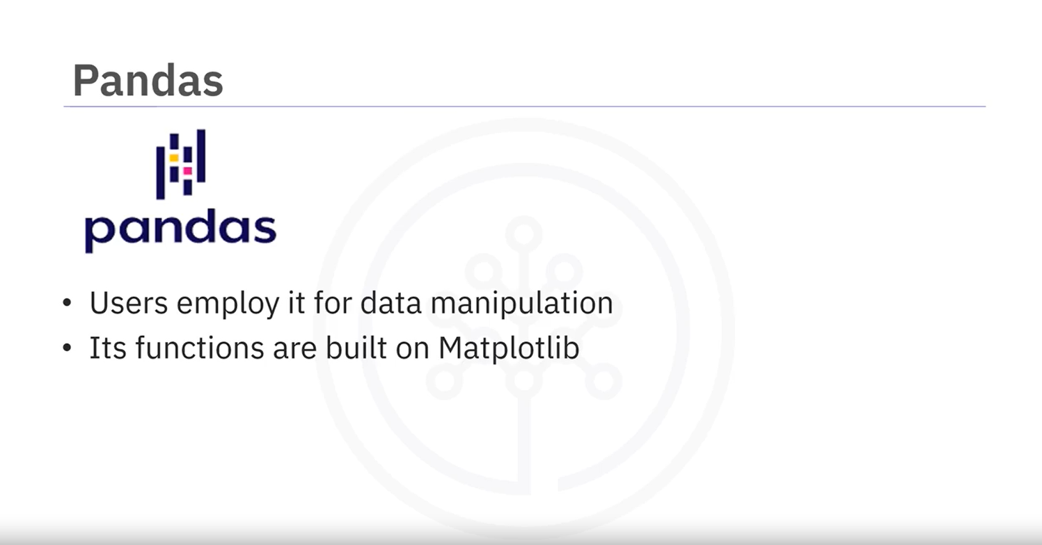
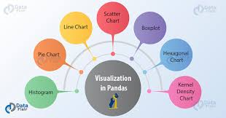
Pandas:
9/4/2024
29

Slide 24
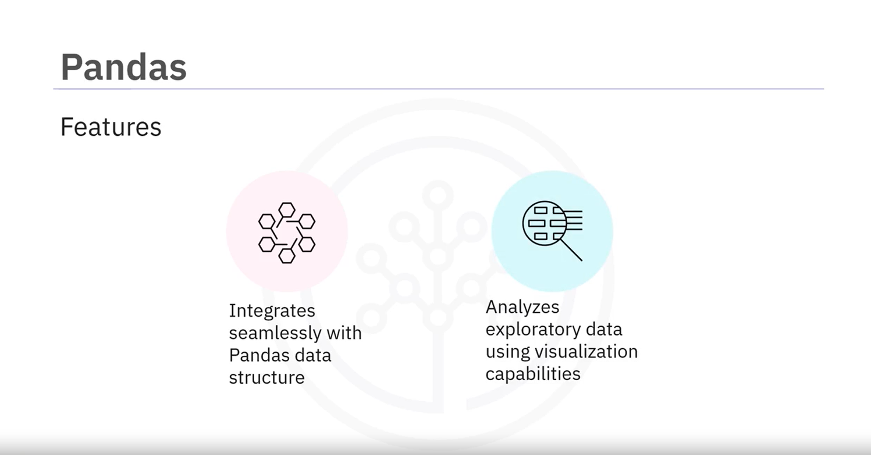
Pandas:
9/4/2024
30

Slide 25
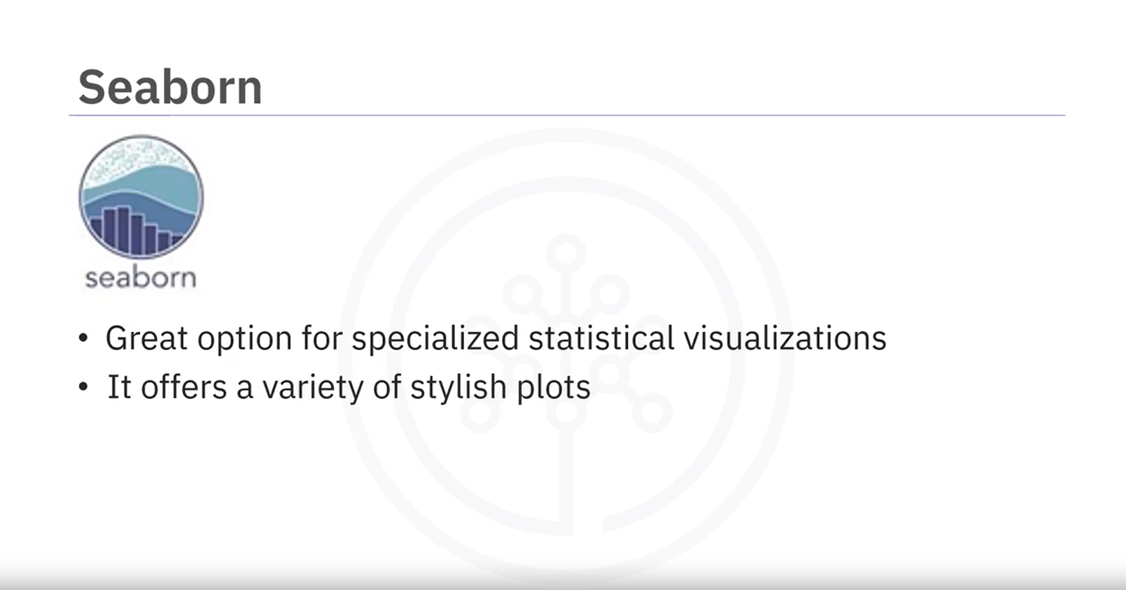
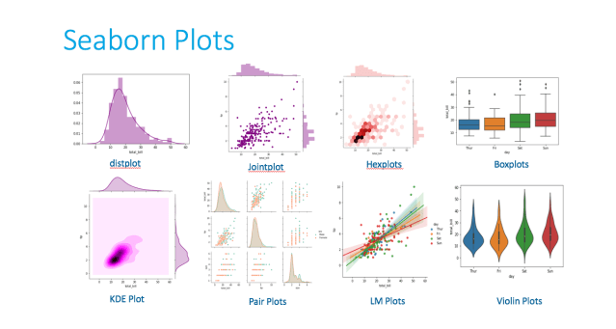
Seaborn:
9/4/2024
31

Slide 26
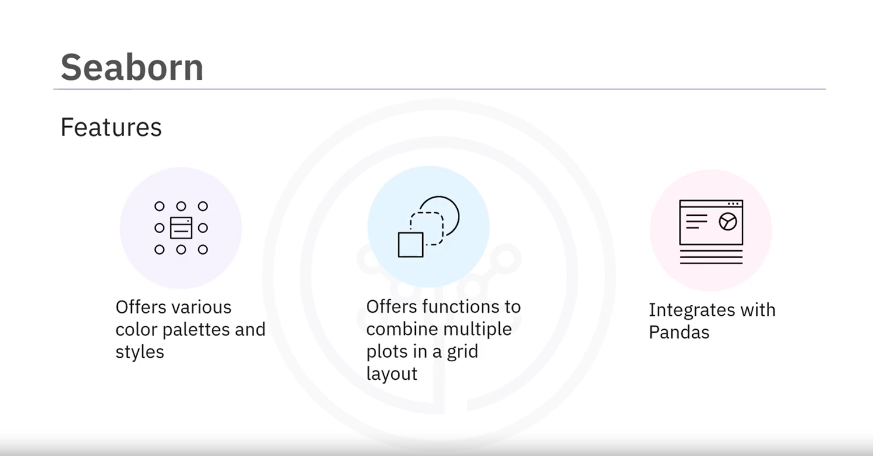
Seaborn:
9/4/2024
32

Slide 27
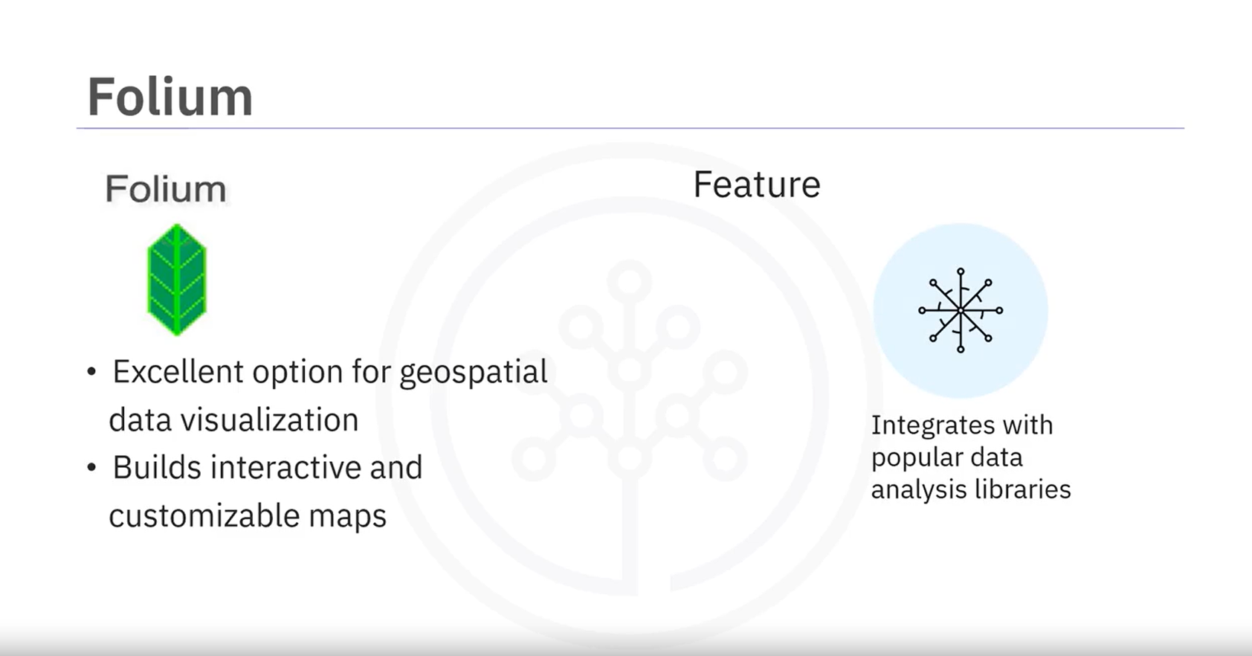
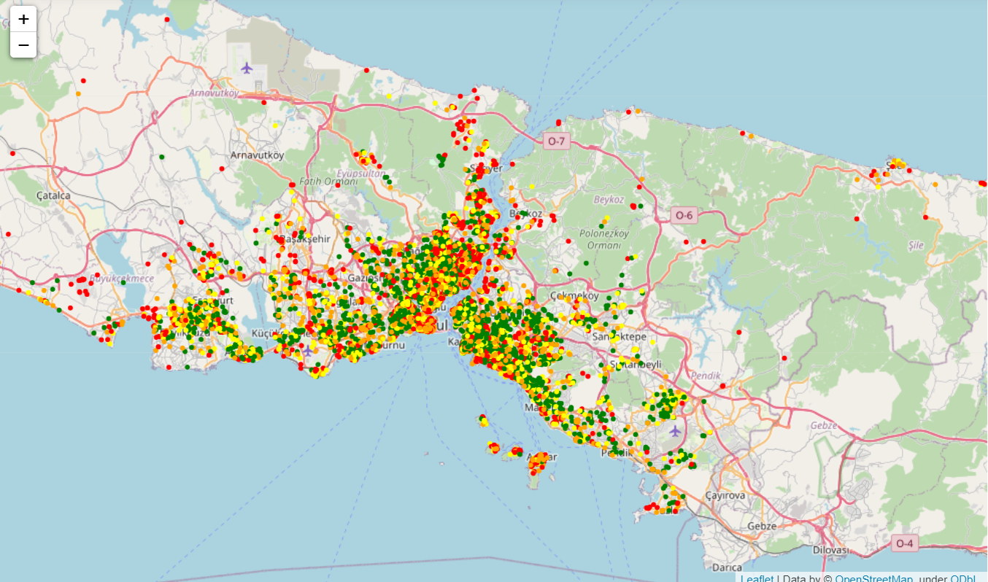
Folium:
9/4/2024
33

Slide 28
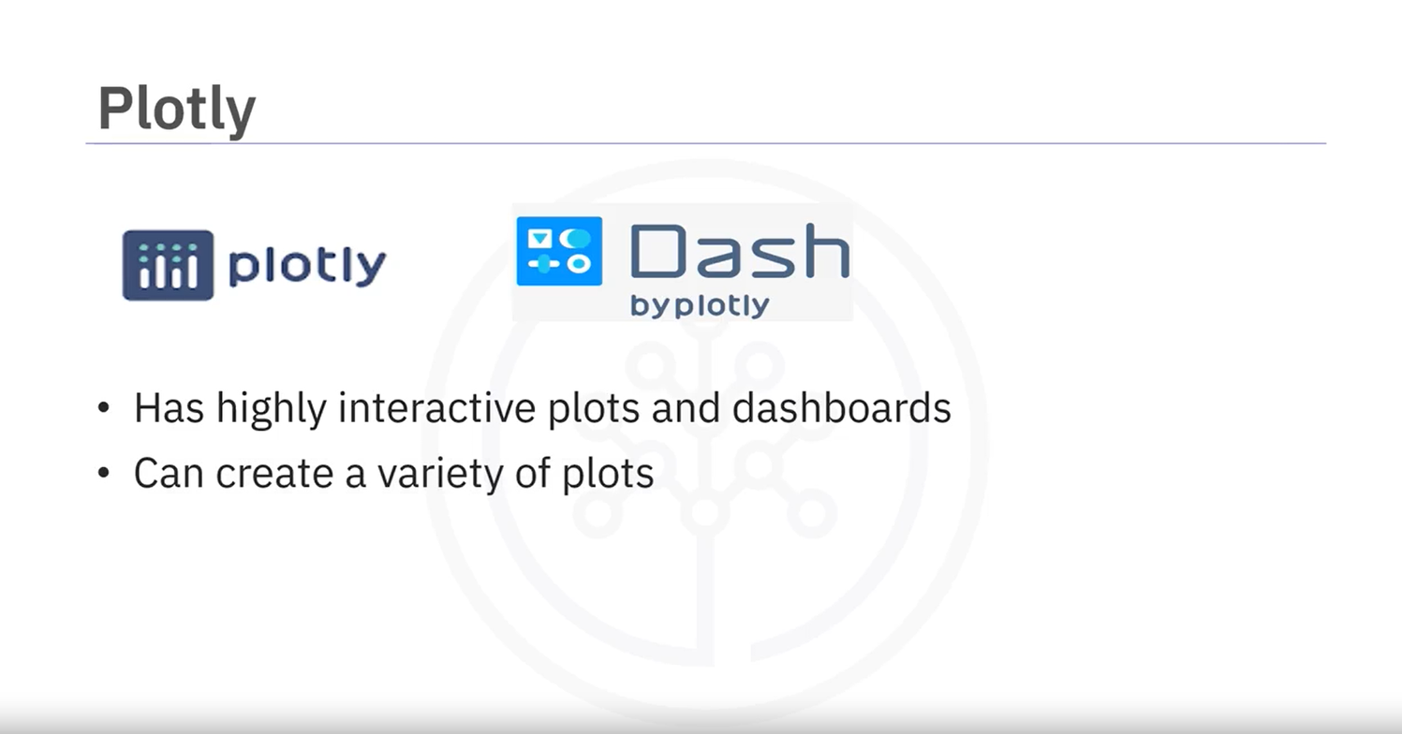
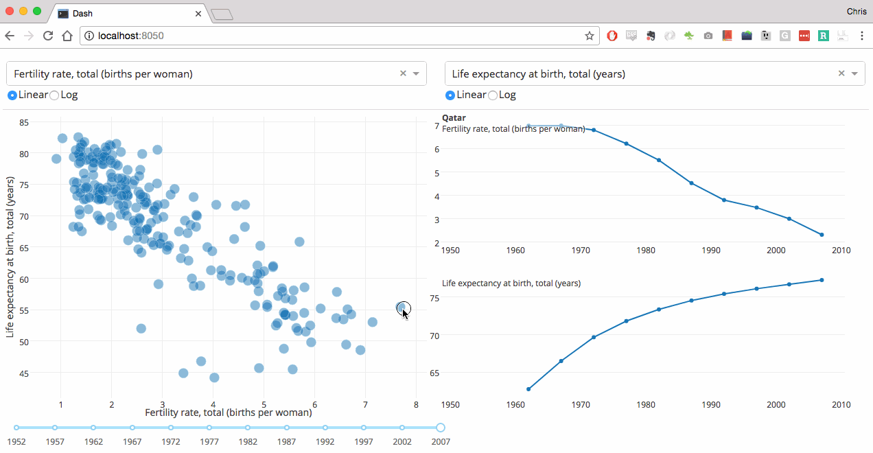
Plotly & Dash:
9/4/2024
34

Slide 29
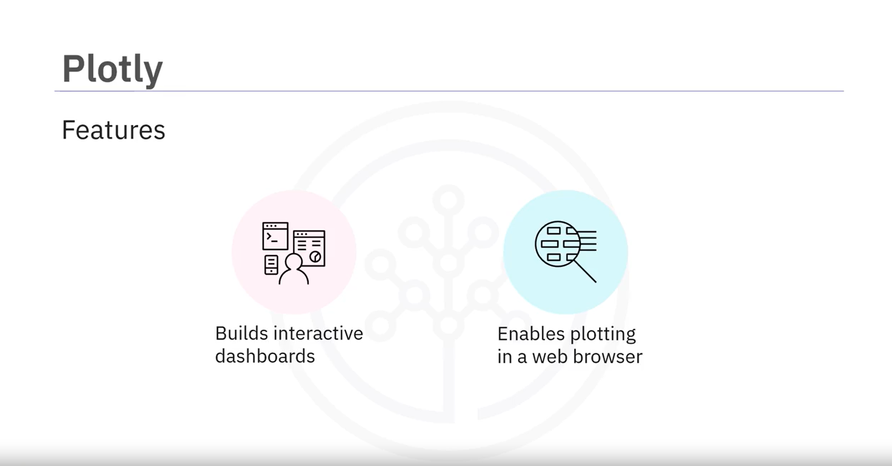
Plotly:
9/4/2024
35

Slide 30
Q&A
Questions and answers
9/4/2024
37

Slide 31
Plotting in Pandas
We will start by seeing how to make basic plots in pandas from data stored in a pandas dataframe.
We will then see how to add the following features to our graphs:
Change titles/axis titles
Annotate the graph
Change the window of the graph
Customizing axis labels
Create multiple plots
In a future lecture, we will then investigate more advanced plotting tools.
Added
By Eng. Baraa

Slide 32
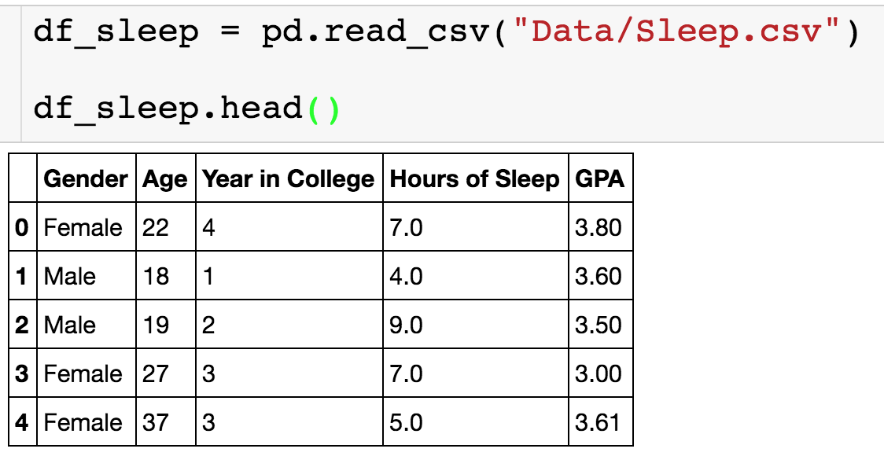
Sleep Data
We have the following data on how hours of sleep is related to GPA.
Added
By Eng. Baraa

Slide 33
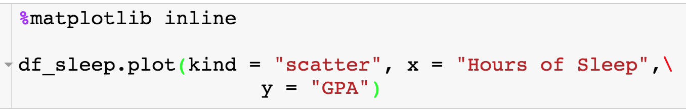
Basic Scatterplot
Makes plot show in Jupyter notebook
Type of plot given as string
Given x,y axis
Added
By Eng. Baraa

Slide 34
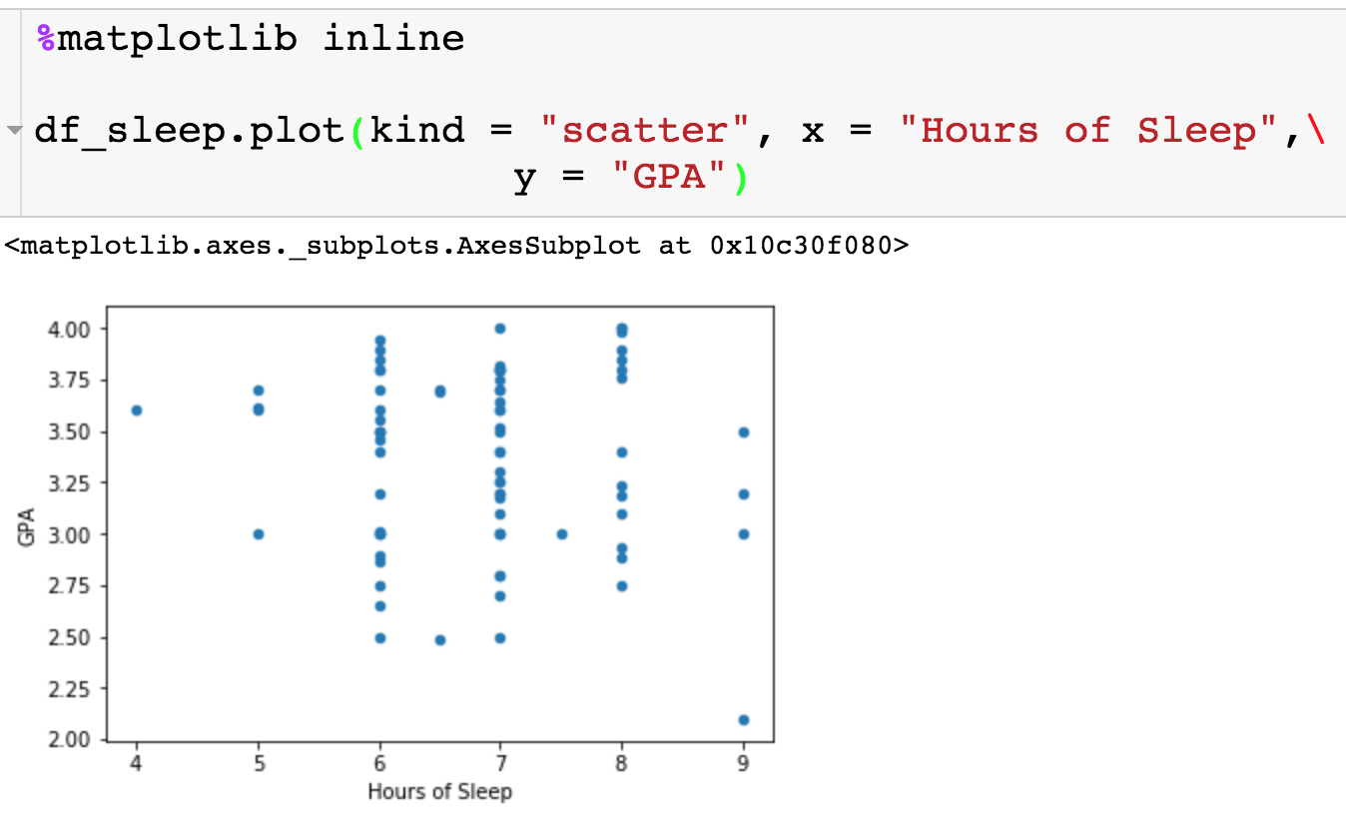
Basic Scatterplot
No title
Added
By Eng. Baraa
Axis labels are column names

Slide 35
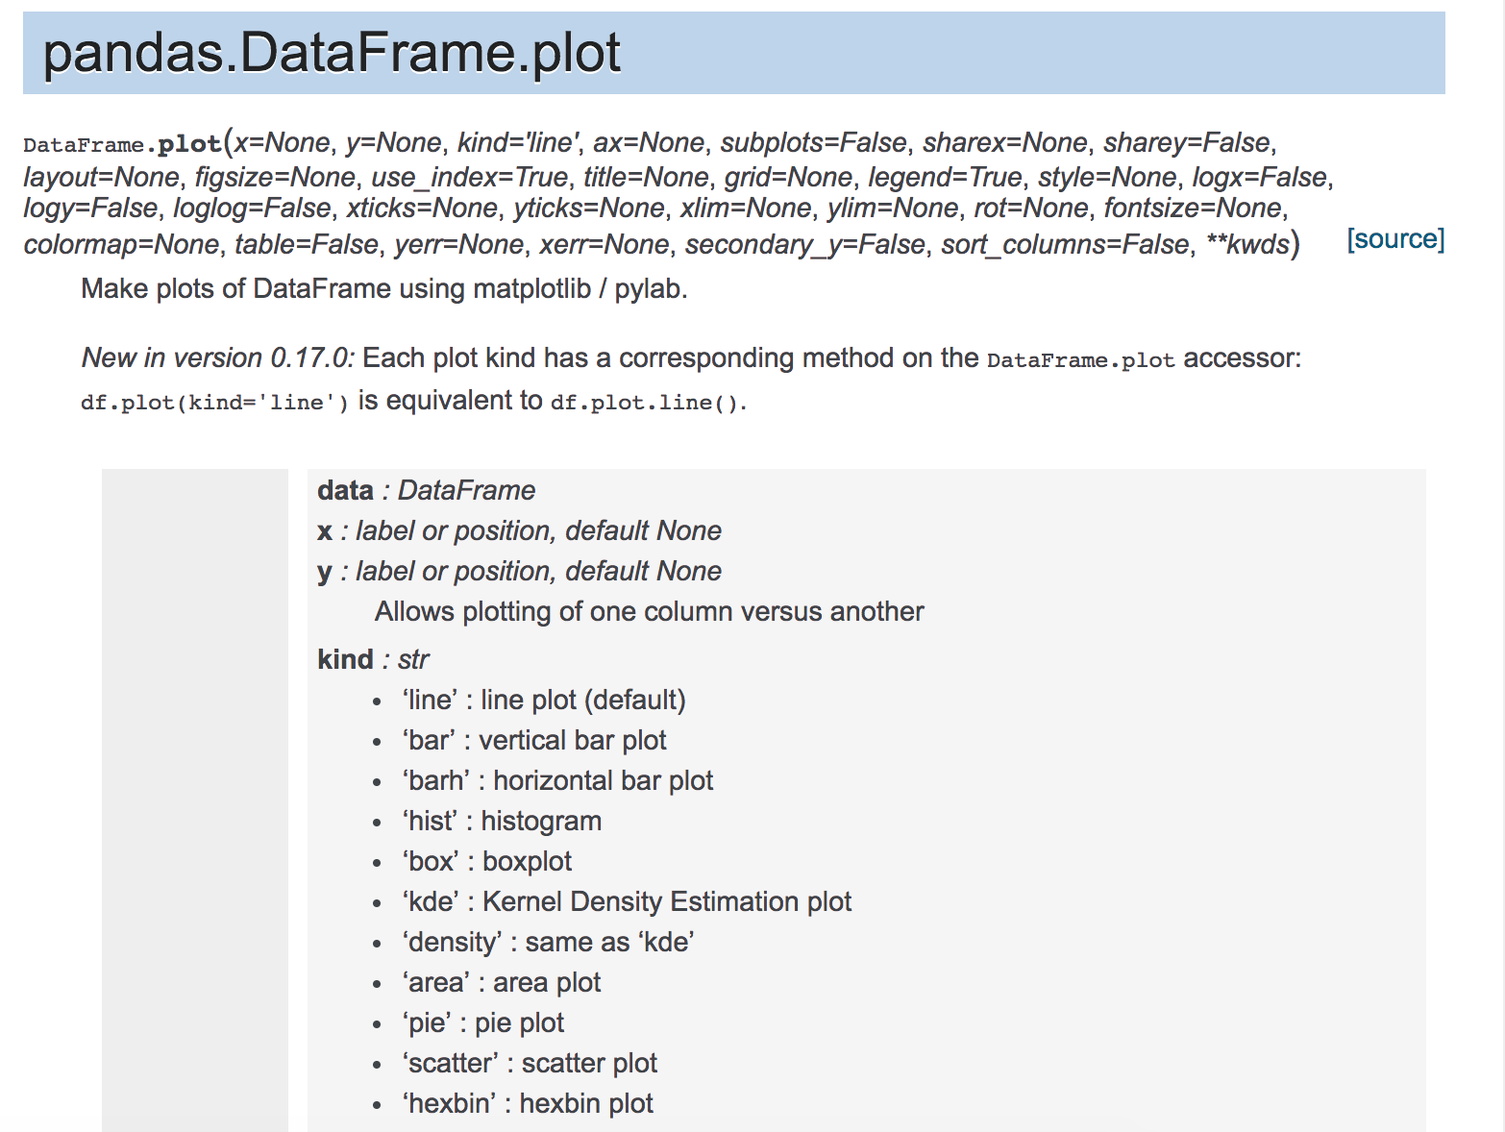
Other Types of Plots
Added
By Eng. Baraa

Slide 36
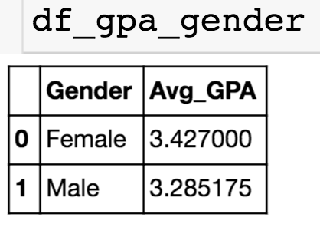
Basic Barplot
I have computed the average GPA for each. I will show you later on how to do this.
Added
By Eng. Baraa

Slide 37
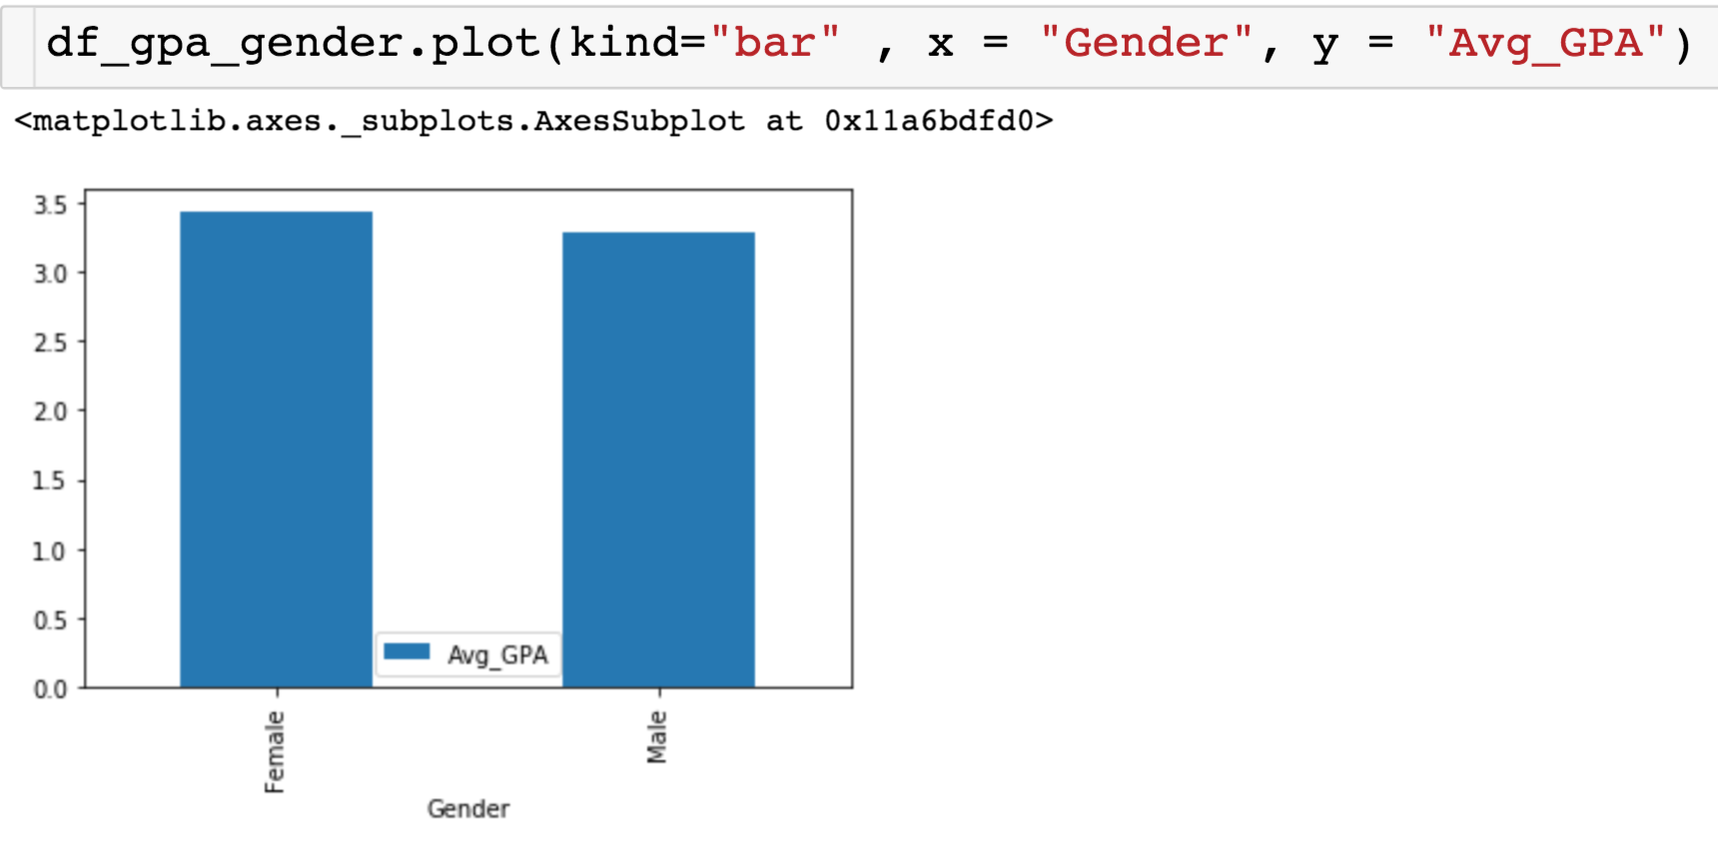
Basic Barplot
Added
By Eng. Baraa

Slide 38
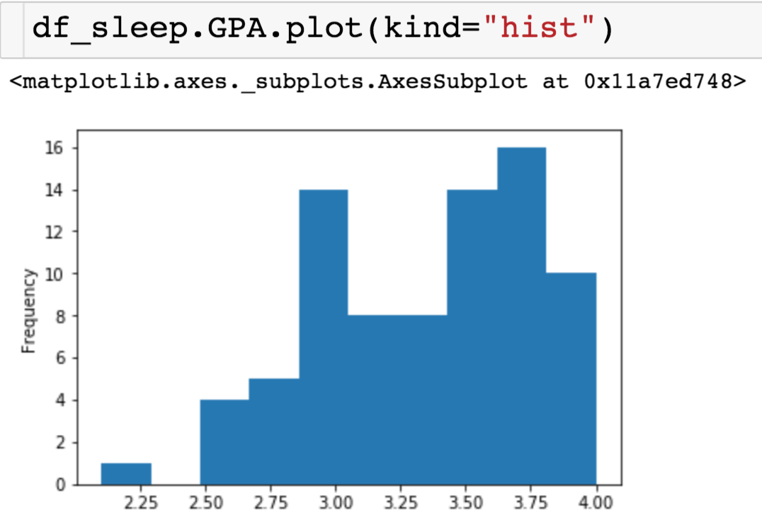
Basic Histogram
Added
By Eng. Baraa

Slide 39
Basic Histogram
Number of bins to use
Think of bins in a histogram as baskets at a market – each one catching data points that fall within a certain range.
The better you choose your baskets, the clearer the story your data tells.
Added
By Eng. Baraa

Slide 40
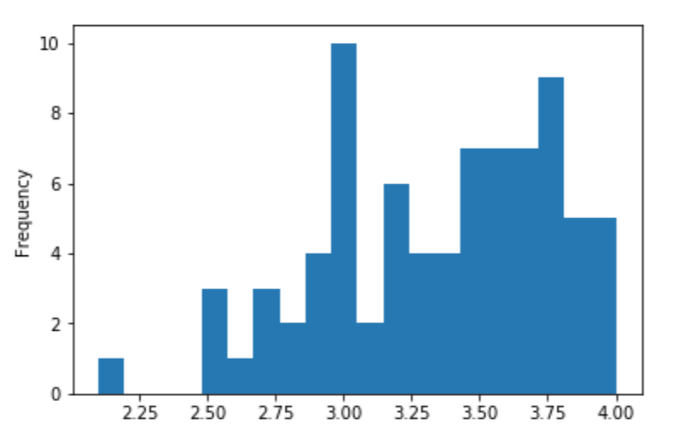
Basic Histogram
Added
By Eng. Baraa

Slide 41
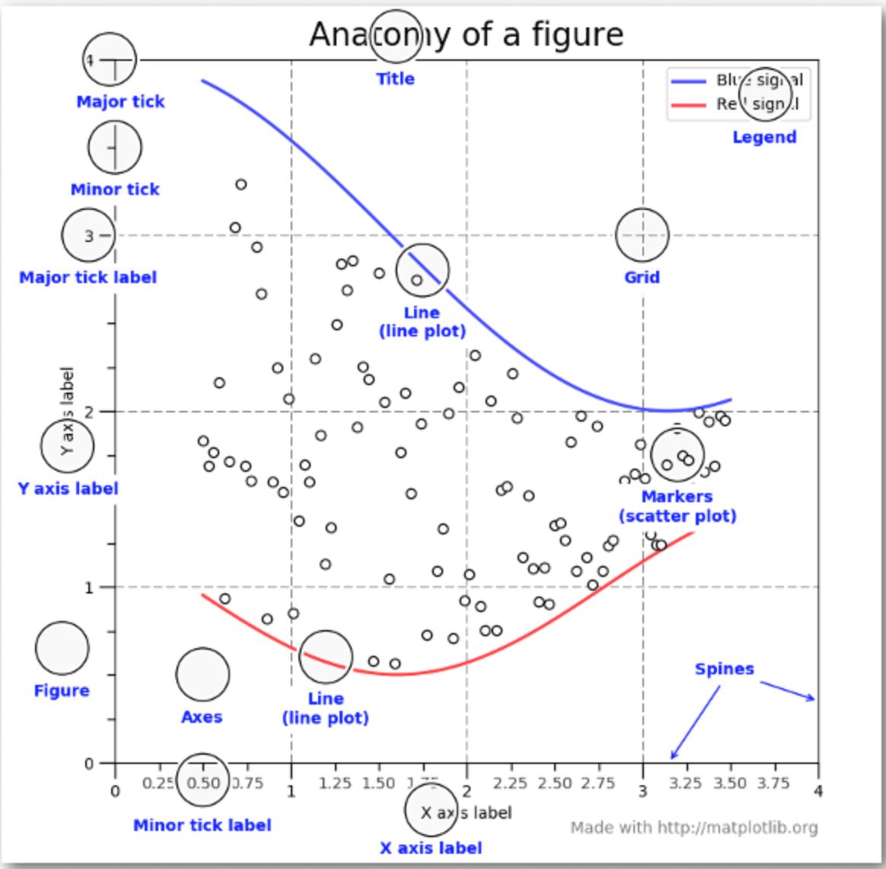
Customizing the Plots
Added
By Eng. Baraa

Slide 42
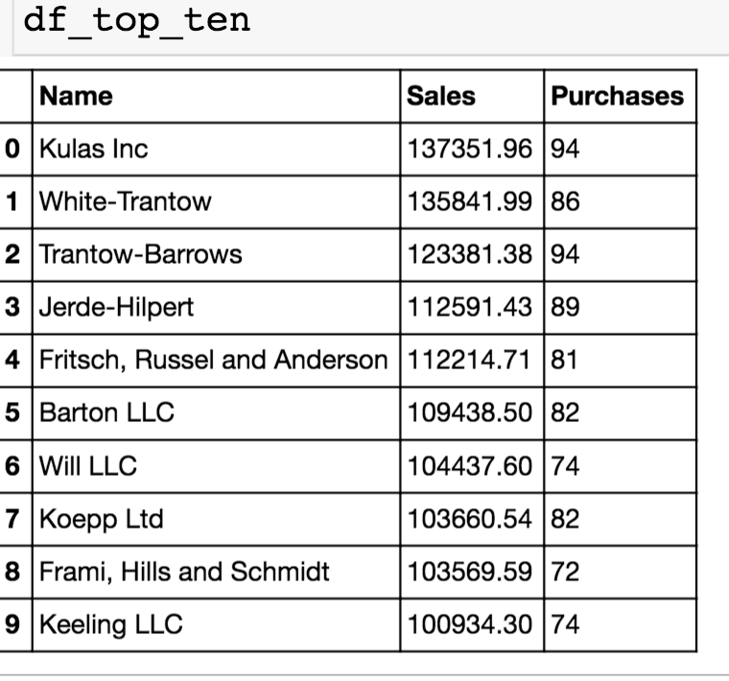
Sales Data
Consider the data from the top 10 customers:
Added
By Eng. Baraa

Slide 43
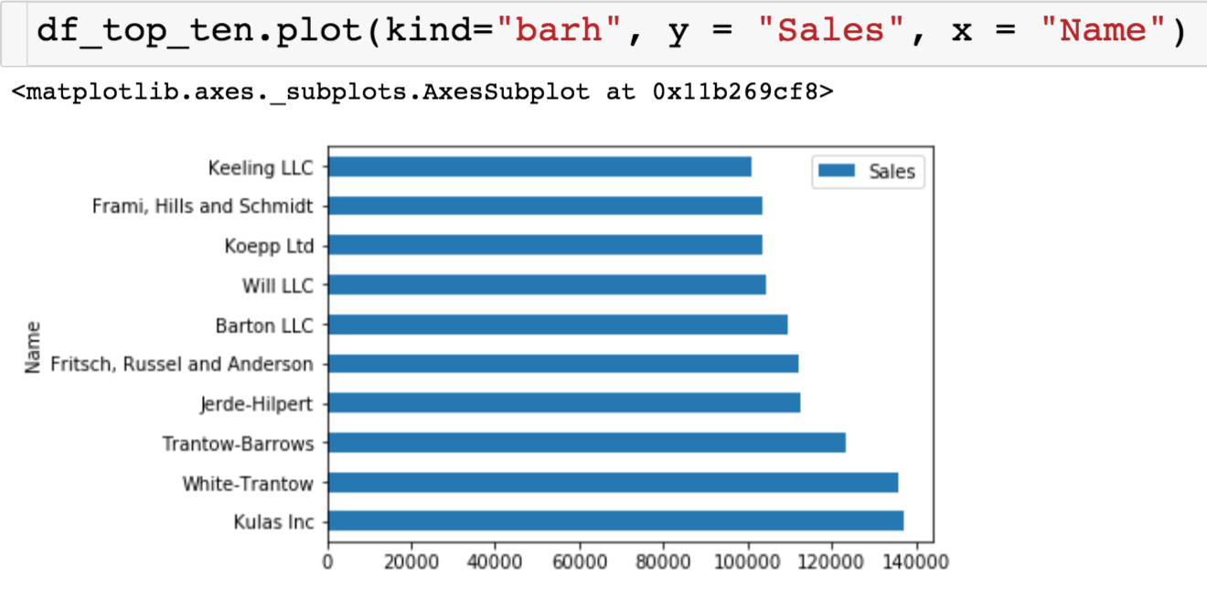
Sales Data
Let’s use pandas to create a basic bar plot and then see how we can manipulate it with matplotlib.
Added
By Eng. Baraa

Slide 44
Introduction to Matplotlib

Slide 45
Introduction to Matplotlib
What is Matplotlib?
Matplotlib is a comprehensive library for creating static, animated, and interactive visualizations in Python. It is highly customizable and is widely used for producing high-quality 2D graphics.
It provides a MATLAB-like interface via the pyplot module, making it easy to create plots by calling a series of simple functions.

Slide 46
Key Features of Matplotlib
Line Plots: Basic line plots for showing trends over time.
Scatter Plots: For visualizing the relationship between two numerical variables.
Bar Charts: Displaying categorical data with rectangular bars.
Histograms: Showing the distribution of numerical data.
Subplots: Creating multiple plots within a single figure.
Customization: Highly customizable with titles, labels, legends, colors, and more

Slide 47
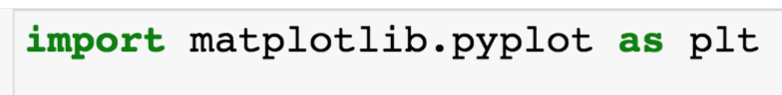
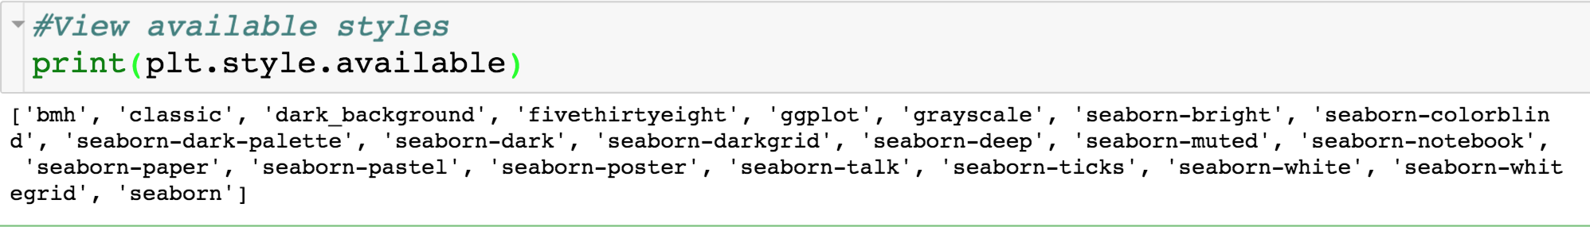
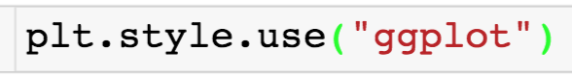
Matplotlib
We need the following import statement when we want to use matplotlib
We can use matplotlib to change the styling of our plots:
We can change the style as follows:
Added
By Eng. Baraa

Slide 48
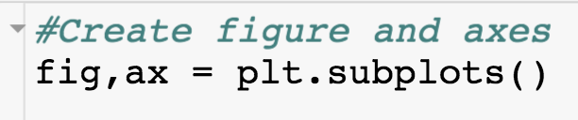
Creating Figure + Axis
You will place something like this line of code before every plot that you create. Creates the following to elements of the visualization you want to produce:
The variable fig will be the figure, which represents the entire visualization. A figure could contain multiple plots.
Adjust size
Number of plots
Boarders
The variable ax represents the axes of a single plot
Change axis limit/labels/ticks
Add multiple plots
Change titles
Added
By Eng. Baraa

Slide 49
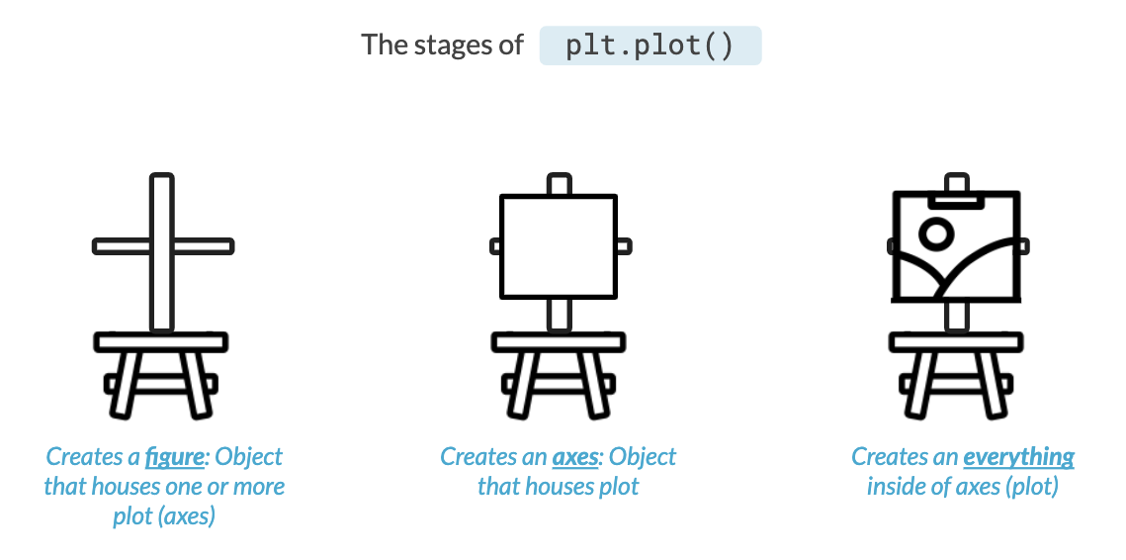
Added
By Eng. Baraa

Slide 50
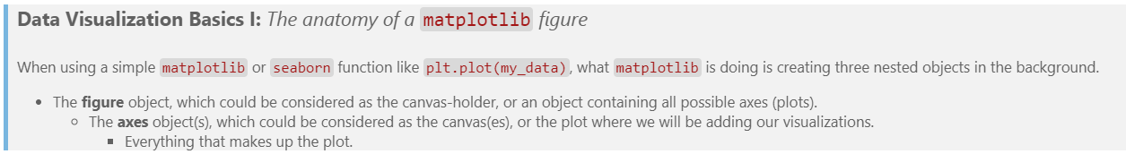
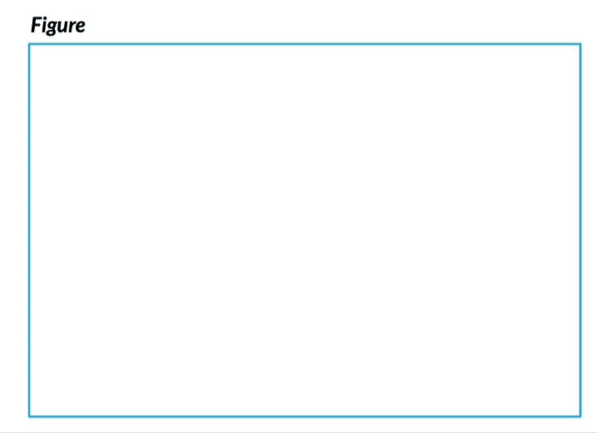
Added
By Eng. Baraa

Slide 51
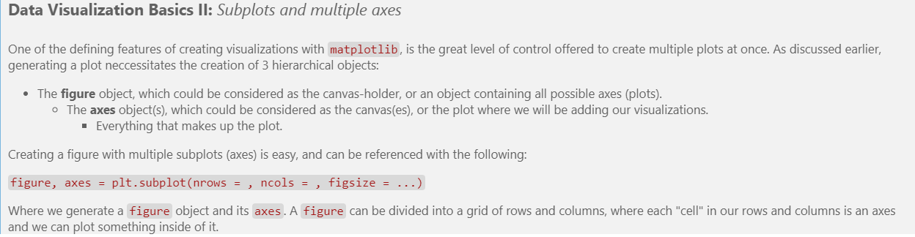

Added
By Eng. Baraa

Slide 52

Creating Figure + Axis
Added
By Eng. Baraa

Slide 53

Adding Barplot to Figure
Same plot, but now we can change the plot using attributes of the variables fig and ax.
Added
By Eng. Baraa

Slide 54

Changing Features of Axes
x-axis only goes up to 140000
Added
By Eng. Baraa

Slide 55

Changing Features of Axes
New axis labels
Added
By Eng. Baraa

Slide 56

Changing Features of Axes
Title
Added
By Eng. Baraa

Slide 57

Change Figure Size
Give list of length of length and width in inches
Added
By Eng. Baraa

Slide 58

Change Figure Size
Added
By Eng. Baraa

Slide 59


Move Legend
loc parameter moves legend
Added
By Eng. Baraa

Slide 60

Move Legend
New legend placement
Added
By Eng. Baraa

Slide 61

Creating Multiple Plots
Added
By Eng. Baraa

Slide 62

Creating Multiple Plots
7x4 Figure, with 1 row and 2 columns of subplots
ax1
ax0
Added
By Eng. Baraa

Slide 63

Creating Multiple Plots
List of lists
12x12 Figure, with 2 rows and 2 columns of subplots
ax1
ax2
ax3
ax4
Added
By Eng. Baraa

Slide 64

Creating Multiple Plots
Notice that all references are made to ax0.
Added
By Eng. Baraa

Slide 65

Creating Multiple Plots
Uh oh! Plots are overlapping. Let’s two options for fixing this.
Added
By Eng. Baraa

Slide 66

Creating Multiple Plots
updated
Added
By Eng. Baraa

Slide 67

Creating Multiple Plots
Added
By Eng. Baraa

Slide 68

All of the Code
Added
By Eng. Baraa

Slide 69

Basic Plotting with Matplotlib
Histogram
A histogram is used to show the distribution of a numerical variable. plt.hist() creates a histogram with a specified number of bins.

Slide 70

Outliers
Outliers are data points that significantly deviate from the rest of the data in a dataset. These anomalies can occur due to inconsistencies in measurement, errors during data collection, or actual variations. Outliers have the potential to distort statistical results and negatively influence machine learning models. Hence, it's crucial to detect and manage them effectively.

Slide 71
Identifying Outliers
Visualization Methods: Techniques such as box plots, scatter plots, histograms, and density plots are valuable tools for detecting outliers visually.
Box Plot: Displays data distribution, highlighting outliers as individual points outside the whiskers.
Scatter Plot: Shows relationships between variables, where outliers can be seen as points far from the main cluster.
Histogram: Illustrates the frequency of data points, with outliers appearing as bars that are distant from the rest.
Density Plot: Provides a smooth curve of the data distribution, with outliers showing up as irregular bumps outside the main peak.

Slide 72
Introduction to Seaborn

Slide 73
Introduction to Seaborn
What is Seaborn?
Seaborn is a Python data visualization library based on Matplotlib. It provides a high-level interface for drawing attractive and informative statistical graphics. Seaborn makes it easy to create complex visualizations, including relationships, categorical data, and statistical plots.

Slide 74
Key Features of Seaborn
Visualizing Distributions: Histograms, KDE plots, and rug plots.
Visualizing Categorical Data: Bar plots, count plots, box plots, and violin plots.
Visualizing Relationships: Scatter plots, line plots, and pair plots.
Heatmaps: For showing data correlations.
Themes: Built-in themes for better-looking plots.

Slide 75

Basic Plotting with Seaborn
Line Plot
This uses Seaborn's lineplot() to create a line plot using the 'tips' dataset, showing the relationship between total bill and tip.

Slide 76

Basic Plotting with Seaborn
Scatter Plot with Regression Line
Seaborn's lmplot() creates a scatter plot with a linear regression line, illustrating the trend between total bill and tip.

Slide 77

Basic Plotting with Seaborn
Bar Plot
barplot() creates a bar chart showing the average total bill for each day of the week. It aggregates the data automatically.

Slide 78

Basic Plotting with Seaborn
Box Plot
boxplot() is used to show the distribution of total bills across different days, highlighting the median, quartiles, and potential outliers.

Slide 79

Basic Plotting with Seaborn
Heatmap
heatmap() visualizes the correlation matrix of the dataset, showing relationships between variables using color gradients.

Slide 80
Practical Visualization Examples

Slide 81

Practical Visualization Examples
Line Plot to Show Trends Over Time
This line plot shows the trend in the number of passengers over time using the 'flights' dataset. It helps to identify overall growth or decline trends.

Slide 82

Practical Visualization Examples
Scatter Plot to Visualize Relationships Between Two Variables
A scatter plot shows the relationship between the total bill and the tip amount in the 'tips' dataset. It helps in identifying patterns or correlations.

Slide 83

Practical Visualization Examples
Bar Plot to Show Categorical Data
This bar plot shows the sum of tips collected for each day. It's useful for comparing categorical data and understanding how different days perform in terms of tip collection.

Slide 84

Practical Visualization Examples
Histogram to Show Data Distribution
This histogram displays the distribution of total bill amounts. The KDE (Kernel Density Estimate) line provides a smoothed version of the distribution, making it easier to see the underlying pattern.

Slide 85

Practical Visualization Examples
Box Plot to Visualize Distribution and Outliers
Box plots provide a summary of the distribution, including median, quartiles, and potential outliers, for the total bill amounts categorized by day.

Slide 86

Practical Visualization Examples
Violin Plot to Show Density and Distribution
Violin plots combine the features of box plots and KDE, showing the distribution and density of total bill amounts by day.

Slide 87

Practical Visualization Examples
Pair Plot to Show Pairwise Relationships
Pair plots display pairwise relationships between different numerical variables in the dataset, helping to identify potential correlations and distributions.

Slide 88

Practical Visualization Examples
Count Plot to Show the Frequency of Categorical Values
Count plots visualize the frequency of occurrences for categorical data. This example shows how many entries exist for each day in the 'tips' dataset.

Slide 89

Practical Visualization Examples
Joint Plot to Show Distribution and Relationship
A joint plot combines a scatter plot and histograms, showing the relationship between total bill and tip amounts, along with their individual distributions.

